Slide 1
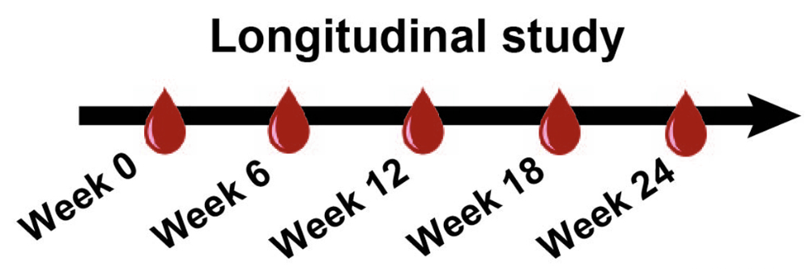
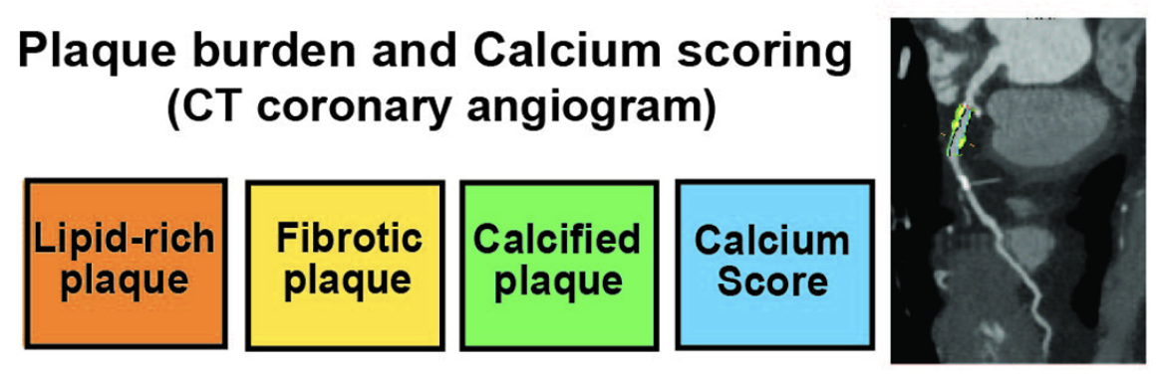
MS analysis
Sequence table
Quantitative lipidomic data
Plaque volume
Data
One line = one subject
One line = one sample of a subject
One line = one sample of a subject
Plaque
variables
Sample-level info
Lipids

